Slide 1
Introduction and History of Python
Functions & Modules

Slide 2
Content
1. Introduction to Python
2. History of Python - Guido van Rossum
3. Evolution of Python Versions
4. Python's Philosophies
5. Functions in Python
6. Anatomy of a Python Function
7. Advanced Function Concepts
8. Modules in Python
9. Module Structure and Organization
10. Benefits of Using Modules
11. Popular Python Modules and Libraries
12. Conclusion

Slide 3
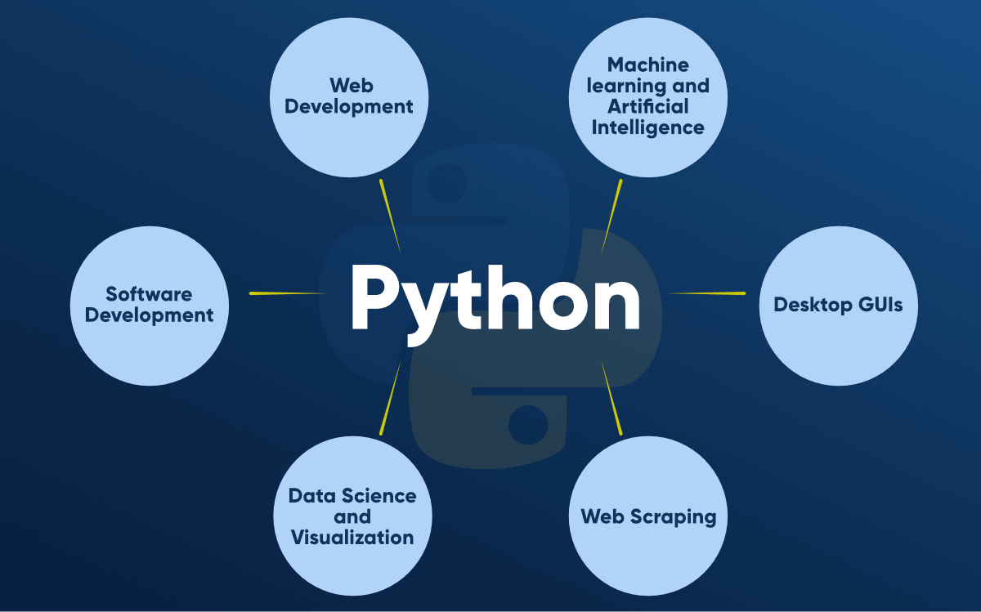
Introduction to Python
Python is a dynamically-typed, high-level programming language with a focus on code readability and simplicity. Created by Guido van Rossum and first released in 1991, Python has evolved into one of the most popular languages globally, powering diverse applications in web development, data science, machine learning, and more.

Slide 4

History of Python - Guido van Rossum
Guido van Rossum, a Dutch programmer, conceived Python as a successor to the ABC language. The first official Python release, Python 0.9.0, came in 1991. Guido's leadership as the 'Benevolent Dictator For Life' (BDFL) shaped Python's development until his retirement in 2018.

Slide 5
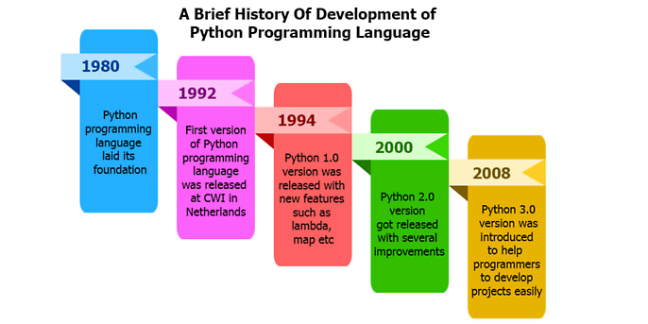
Evolution of Python Versions
Python has seen significant version releases, with Python 2 and Python 3 being the most notable. Python 2, initially released in 2000, reached its end-of-life in 2020. Python 3, introduced in 2008, is the current and recommended version for development.

Slide 6
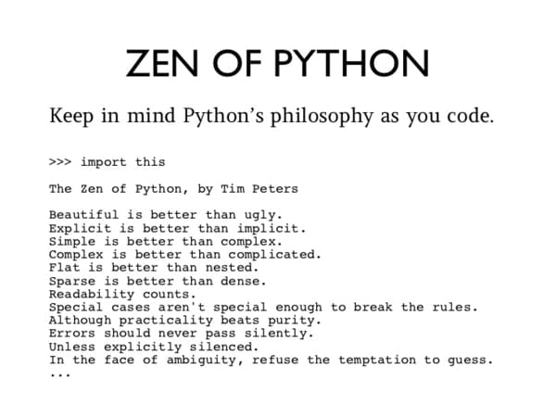
Python's Philosophies
Python follows a set of guiding principles, often referred to as 'The Zen of Python,' which includes aphorisms like 'Readability counts' and 'There should be one-- and preferably only one --obvious way to do it.' These philosophies contribute to the language's design and community culture.

Slide 7
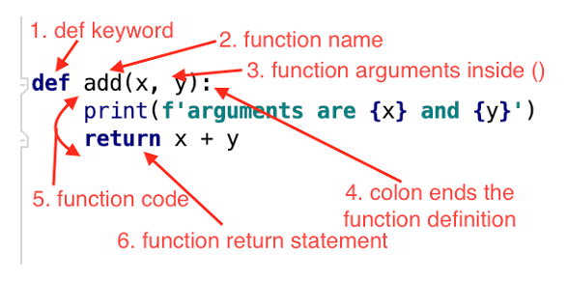
Functions in Python
Functions in Python are fundamental building blocks for organizing code. Defined using the 'def' keyword, functions encapsulate a set of instructions and can accept parameters and return values. They enhance code modularity and maintainability.

Slide 8
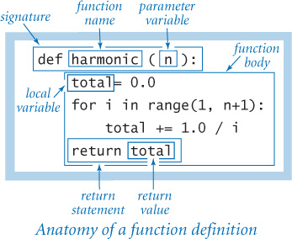
Anatomy of a Python Function
A Python function consists of a name, parameters (optional), a function body with indented code, and a return statement (optional). Functions can be called with arguments, allowing for flexibility and reusability.

Slide 9
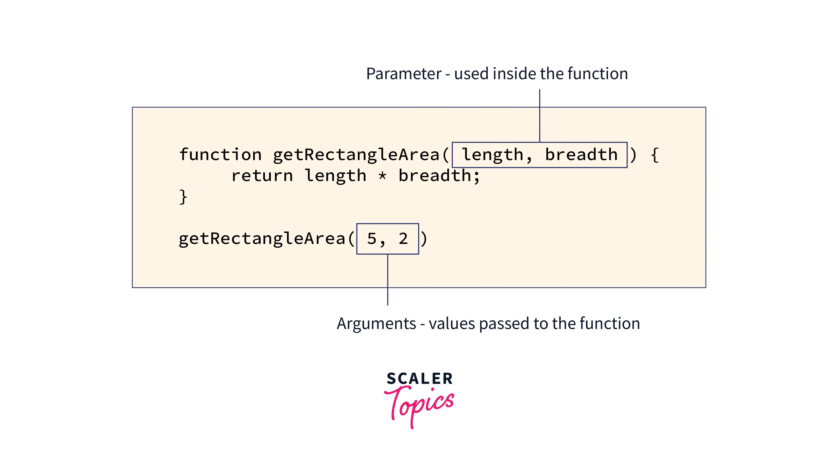
Advanced Function Concepts
Python functions support features like default parameter values, variable-length argument lists, and lambda functions. Additionally, the concept of closures and decorators allows for advanced function manipulation.

Slide 10
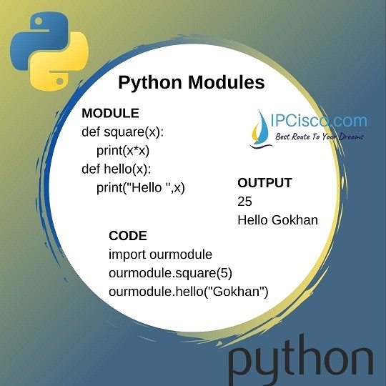
Modules in Python
Modules in Python serve as organizational units, grouping related code into separate files. They promote code reuse and maintainability by providing a way to structure large projects. Modules are imported using the 'import' statement.

Slide 11
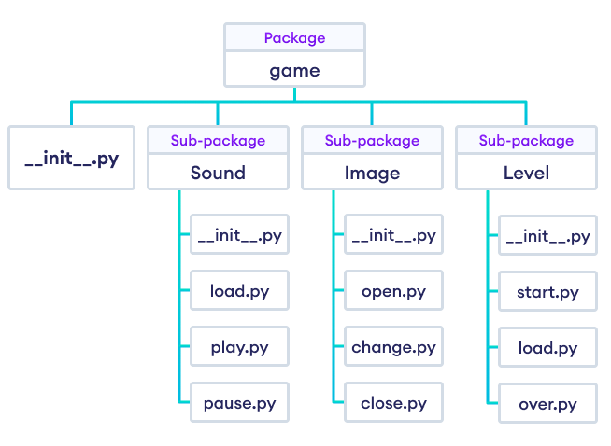
Module Structure and Organization
A Python module typically includes functions, variables, and classes. Modules can be organized into packages, forming a hierarchical structure. Proper module organization contributes to a clear and maintainable codebase.

Slide 12
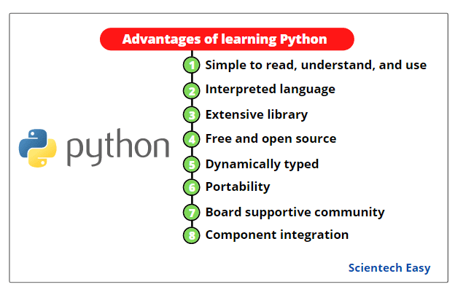
Benefits of Using Modules
Using modules enhances code readability, simplifies maintenance, and supports code reuse. Modules also facilitate collaborative development, allowing multiple developers to work on different parts of a project simultaneously.

Slide 13
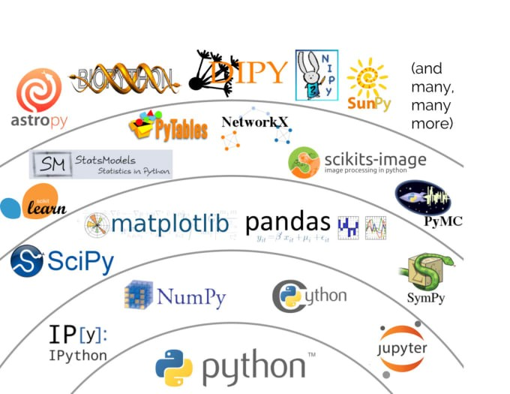
Popular Python Modules and Libraries
Python has a vast ecosystem of modules and libraries. Notable examples include NumPy for numerical computing, pandas for data manipulation, and requests for HTTP interactions. Leveraging these libraries enhances Python's capabilities across various domains.

Slide 14
Conclusion
Python's rich history, clear syntax, and extensive standard library make it a powerful and versatile programming language. Whether you're a beginner or an experienced developer, Python's simplicity and readability make it a language of choice for various applications.

Slide 15
Thank You

